Slide 1


National Education Society®
JNN College of Engineering, Shivamogga
Dept. of Information Science and Engineering
Project Phase-1 presentation on
“Cross Booth Voting System with Aadhar-Linked Authentication and Real-Time Data Synchronization”
Batch : 04
Under guidance of :
Mrs. G.V. Sowmya, B.E, M.Tech
Presented by :
Subhash G.K 4JN22IS153
Suraj R.K 4JN22IS157
Tilak S 4JN22IS168
Vijay 4JN22IS417

Slide 2
Content
Problem Statement
Introduction
Key Objectives
Proposed Solutions
Work flow
Software used
Advantage
Result
Conclusion

Slide 3
Problem Statement:
India, as the largest democracy in the world, faces challenges in ensuring secure, transparent, and accessible voting for all its citizens.
Many voters face logistical challenges like being away from their registered voting locations during elections. Remote voting can help address this issue.
Aadhaar, the unique identification system in India, can be leveraged for secure voter authentication in a remote voting system.

Slide 4
Introduction
This system leverages advancements in digital identity verification and real-time data synchronization technologies to enable voters to cast their votes remotely, regardless of their physical location.
By integrating Aadhar-based authentication, the system ensures that only eligible voters are allowed to vote, enhancing the security and accuracy of the process.
Real-time data synchronization ensures that votes cast from different locations are instantly updated and recorded in a centralized database, reducing the risk of fraud, duplication, and data inconsistency.

Slide 5
Traditional voting systems:
Require voters to cast their vote only at their registered polling station.
Inconvenient for those away from their home location.
Challenges Faced:
Lack of accessibility for remote voters.
Absence of real-time synchronization for cross-booth voting.
Security concerns in voter identification.

Slide 6
Key Objectives
Ensure secure and authenticated voting using Aadhar data.
Enable seamless cross-booth voting with location-based candidate mapping.
Provide real-time updates to ensure transparency and prevent discrepancies.
Maintain the integrity of election data across multiple locations.

Slide 7
Proposed Solution
Remote Voting System Features:
Aadhar-Linked Voter Authentication: Secure verification of voters using their Aadhar details.
Cross-Booth Voting: Voters can cast votes for candidates of their home location from any booth.
Real-Time Data Synchronization: Instant vote updates across all database systems.

Slide 8
Components:
Voter Module (Authentication)
Admin Panel (Verification & Monitoring)
Candidate Database (Dynamic Location-Based Panels)
Real-Time Synchronization Layer (Vote Count Updates)
Data Flow:
Admin login through password.
Voter login via Aadhar.
Admin verifies and assigns booth-specific candidate data.
Vote submission updates all systems instantly.

Slide 9
Authentication Process
Steps :-
Voter provides Aadhar-linked Voter ID.
Admin verifies voter data in real-time.
Voter’s registered home booth and location are identified.
Admin opens the corresponding candidate panel for voting.

Slide 10
Cross Booth Voting Workflow
Voter's Location:
Identify the home booth ID from the database.
Dynamic Candidate Mapping:
Open candidate panel for the voter’s registered location.
Vote Casting:
Allow the voter to choose a candidate.
Vote Synchronization:
Instantly update the vote count across all systems.

Slide 11
Real-Time Data Synchronization
Database Design:
Centralized system with interconnected booth databases.
Key Features:
Immediate vote count updates.
Conflict-free data synchronization.
Secure encryption for data transfer.

Slide 12
Security Features
Aadhar Authentication:
Prevents duplicate or unauthorized votes.
Encryption:
Secures voter and vote data during transmission.
Audit Trails:
Logs all activities for transparency and dispute resolution.

Slide 13
User Interfaces
Admin Panel:
Login, voter verification, and candidate panel management.
Voter Panel:
Simple interface to select candidates and submit votes.
Result panel:
Simple interface to show the candidate votes

Slide 14
Software used in these project
XAMPP
Local server environment (Apache, MySQL, PHP).
PHP
Server-side scripting for backend logic.
MySQL
Database to store and manage voter, candidate, and admin data.
phpMyAdmin
Web-based tool to manage the MySQL database.
HTML
For structuring the web pages (e.g., forms, buttons).
CSS (Optional)
To style and design the interface.
Code Editor (e.g., VS Code, Notepad++) To write and edit PHP, SQL, and HTML code.

Slide 15
Advantages
Accessibility for remote voters.
Real-time vote tracking and synchronization.
Prevents fraudulent activities with Aadhar verification.
Simplifies the election process for both voters and administrators.

Slide 16
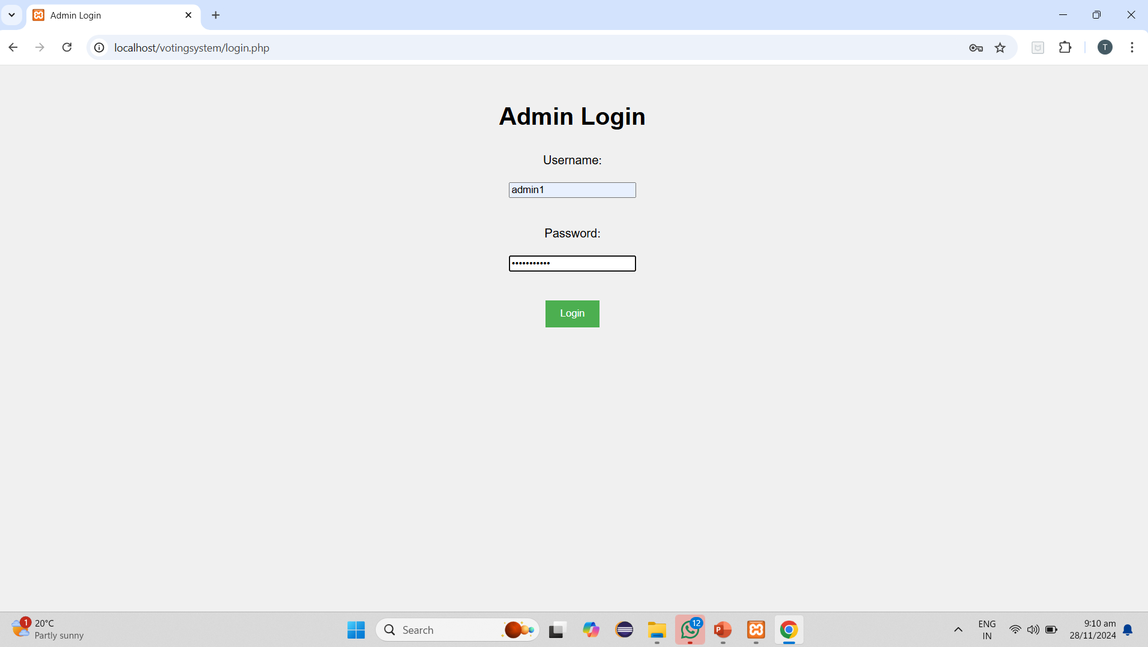
RESULT
1.Admin login:-

Slide 17
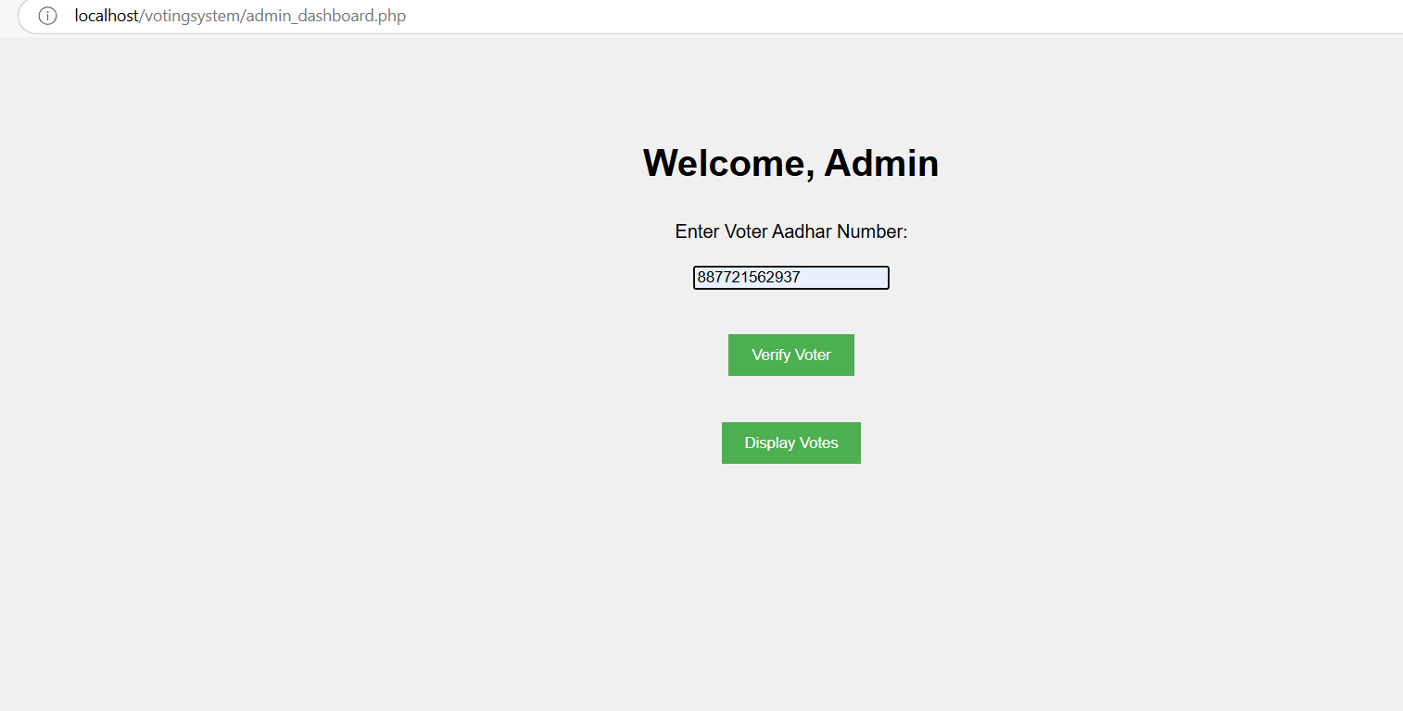
2.Admin dashboard:-

Slide 18
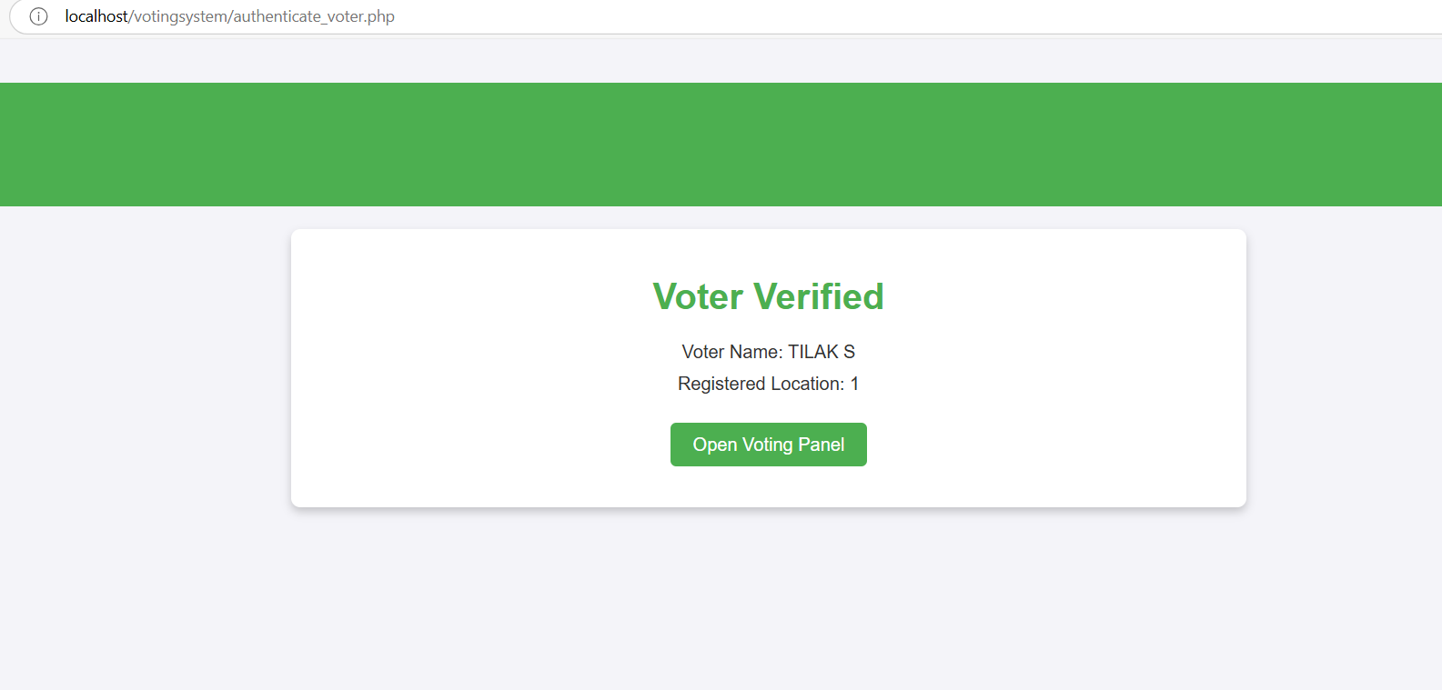
3. Authenticate voter:-

Slide 19
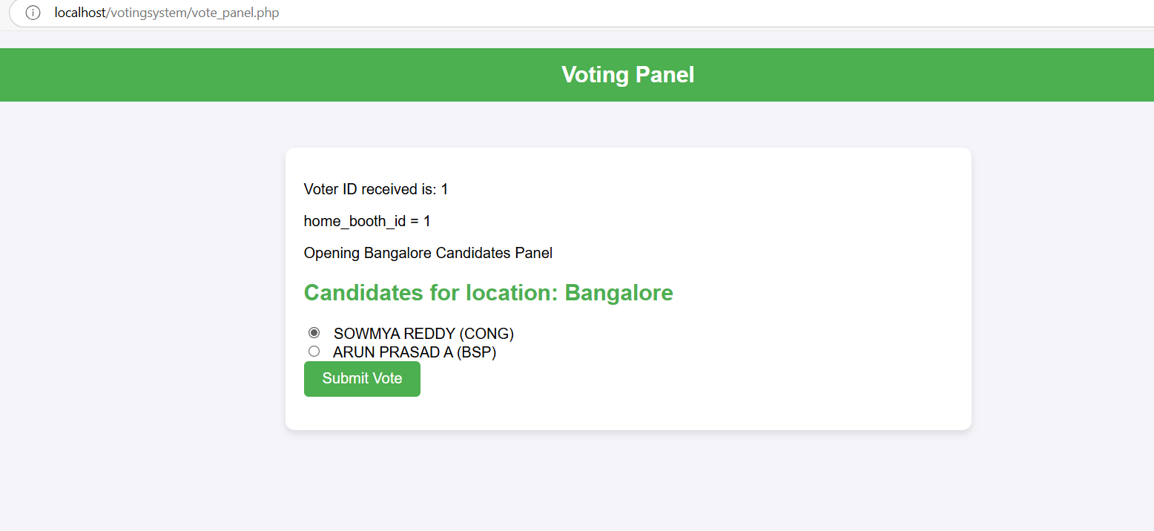
4. Voting Panel

Slide 20
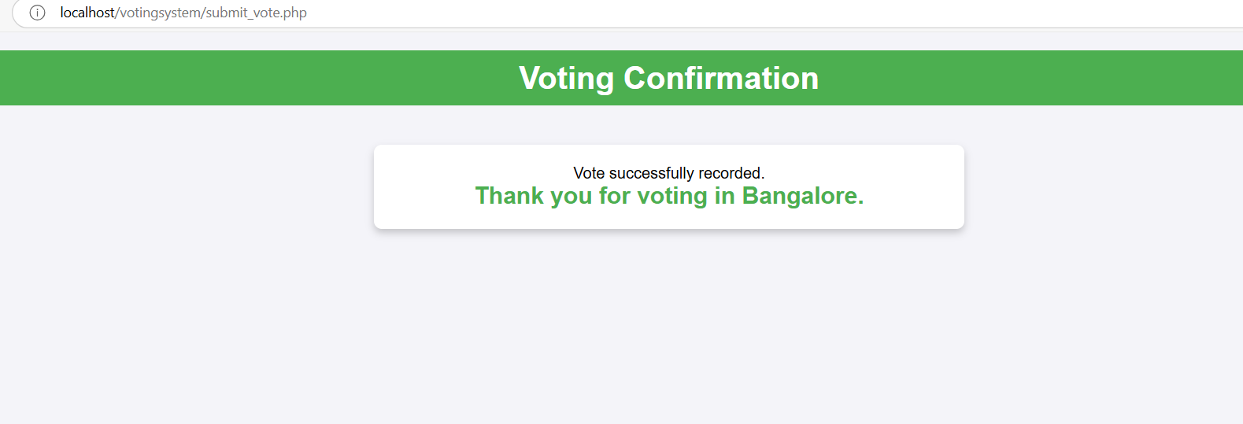
5.Voting Confirmation

Slide 21
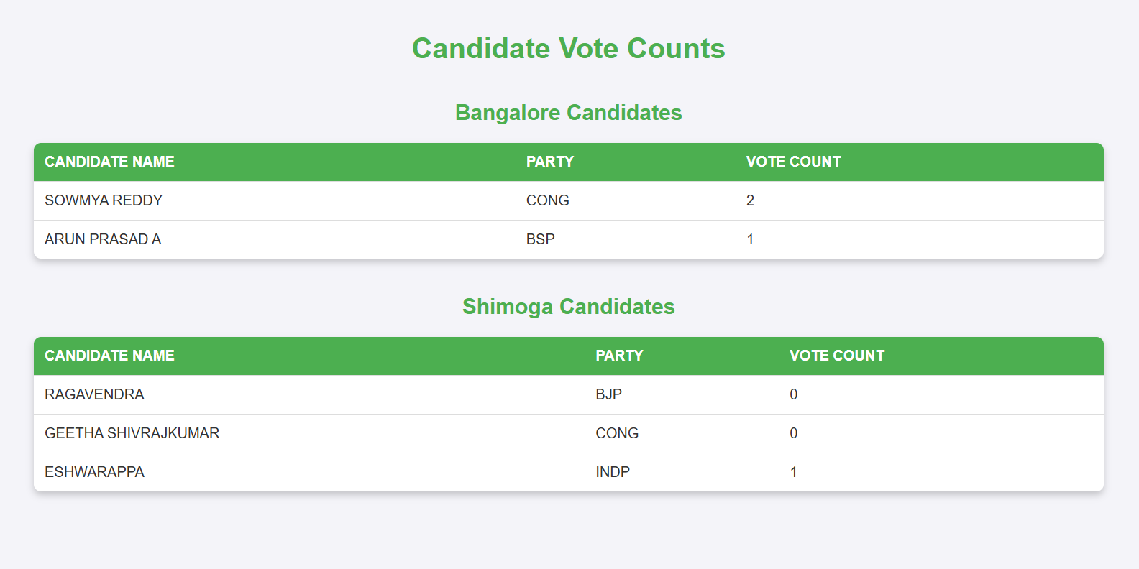
6. Result Panel:-

Slide 22
Future enhancement
Support for Multiple Elections
Current State: The system supports only one election at a time.
Enhancement: Implement support for multiple elections to allow the system to handle different types of elections (e.g., local, state, or national elections) at the same time. This would require a more flexible data model and election-specific configurations.
Disaster Recovery and Backup
Current State: No backup or disaster recovery plan is mentioned.
Enhancement: Implement regular backups of the database and create a disaster recovery plan to ensure that data is not lost in case of system failures or outages.

Slide 23
Conclusion
Overall, the Voting System project serves as a promising platform for electronic elections, providing a secure environment for voters to cast their votes while allowing admins to manage and monitor the process efficiently. However, for broader adoption and to handle complex, large-scale elections, it requires further enhancements in terms of security, user experience, scalability, and real-time features

